Slide 1
Project 02:
Military, Health, and Education
Kloe Truvan

Slide 2
Datasets Used
SIPRI Military Expenditure Database | Military Expenditure Data (SIPRI)
Education Expenditure Data (UNESCO) | Health Expenditure Data
Notes:
Here i used four datasets; the sipri, military, education, and health data sheets

Slide 3
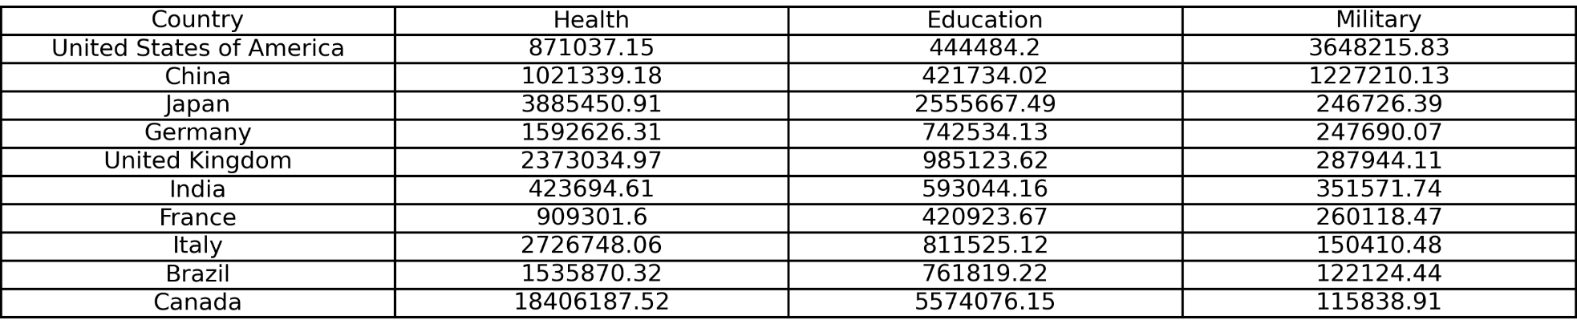
Top 10 Countries
Total Spending (2017-2021)
Notes:
Here are my top 10 countries. I found them by taking the military spending per country and multiplied it by the military expenditure as a percent of gdp.

Slide 4
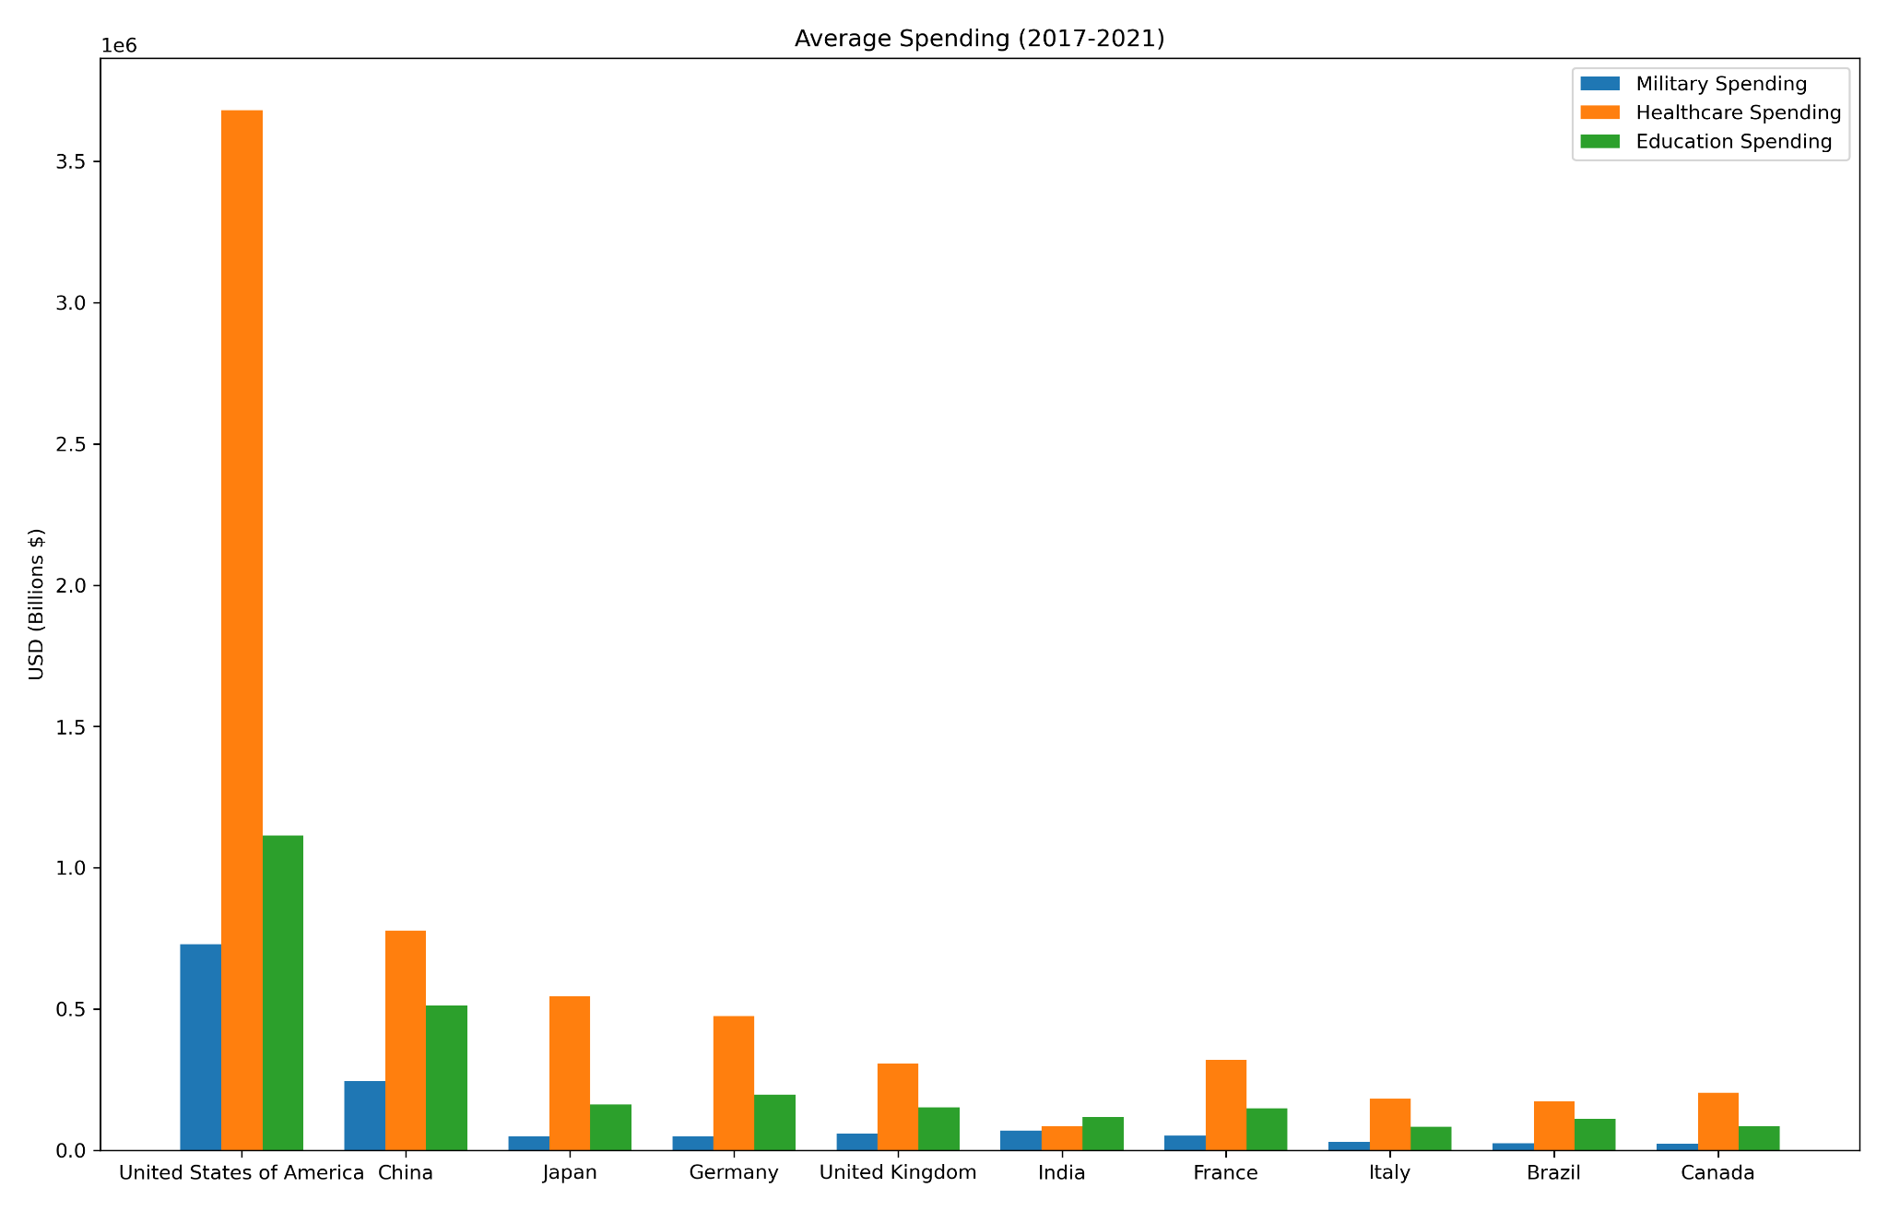
Average Spending
Notes:
This is the average spending across all three categories. The values are in US billions. The US is the top spender overall, with india spending the least. Although india’s spending seems evenly distributed across all three categories, they are spending the least. We can also see healthcare is a big focus across all top 10 countries.

Slide 5
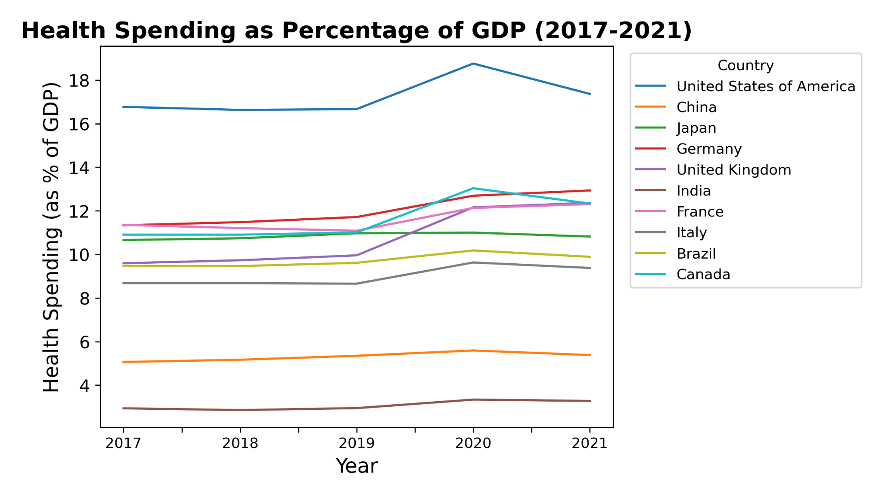
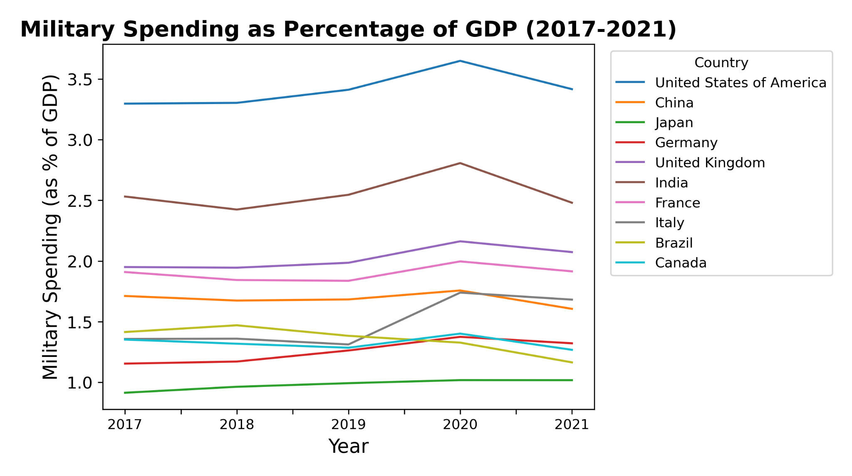
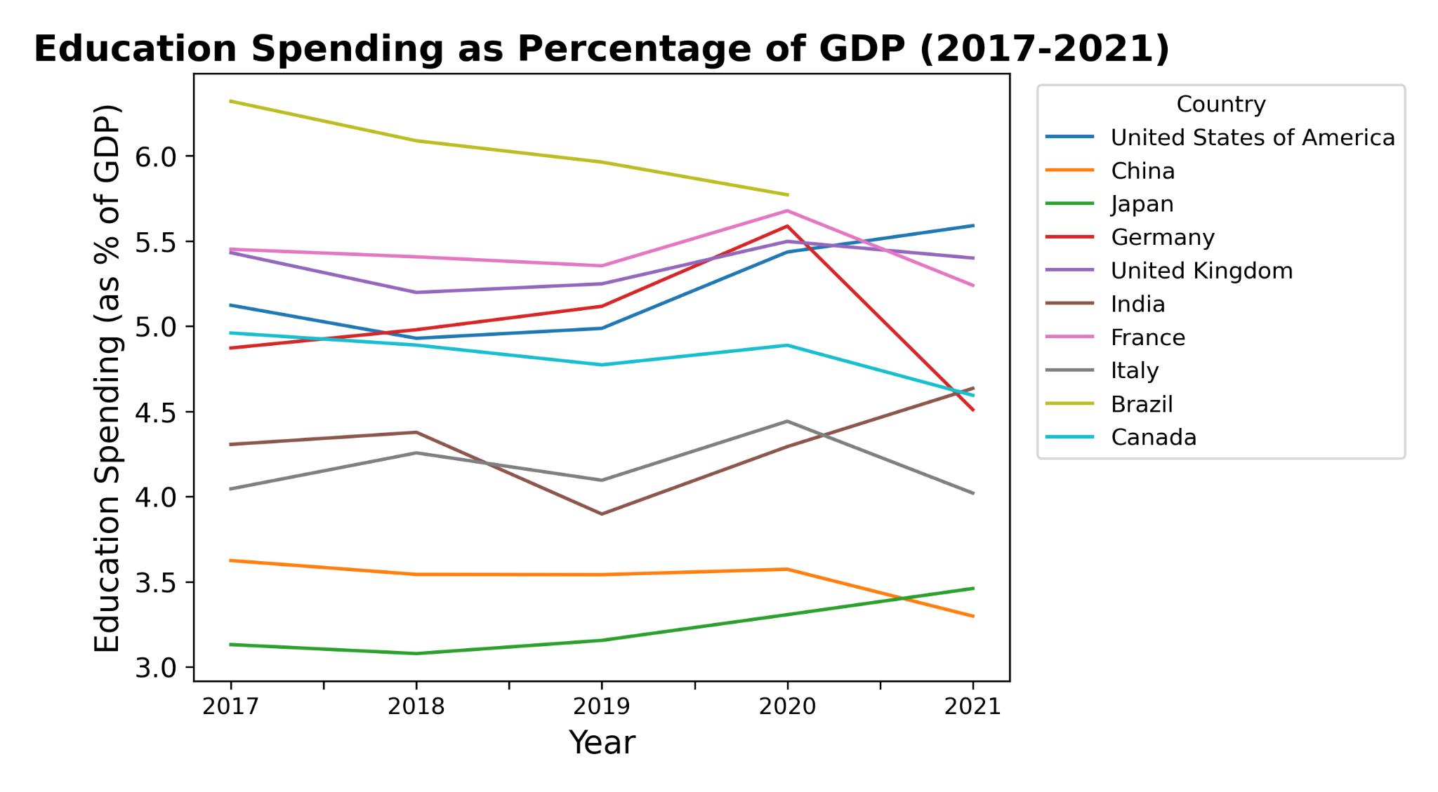
Military, Education, and Healthcare Spending
As Percentage of GDP
Notes:
Here we have the spending as a percentage of gdp line plots. For both military and healthcare spending, the united states spends the most. And in both military and education spending, japan spends the least. The line for brazil in the education line plot ends since there was no data for brazil in 2021.

Slide 6
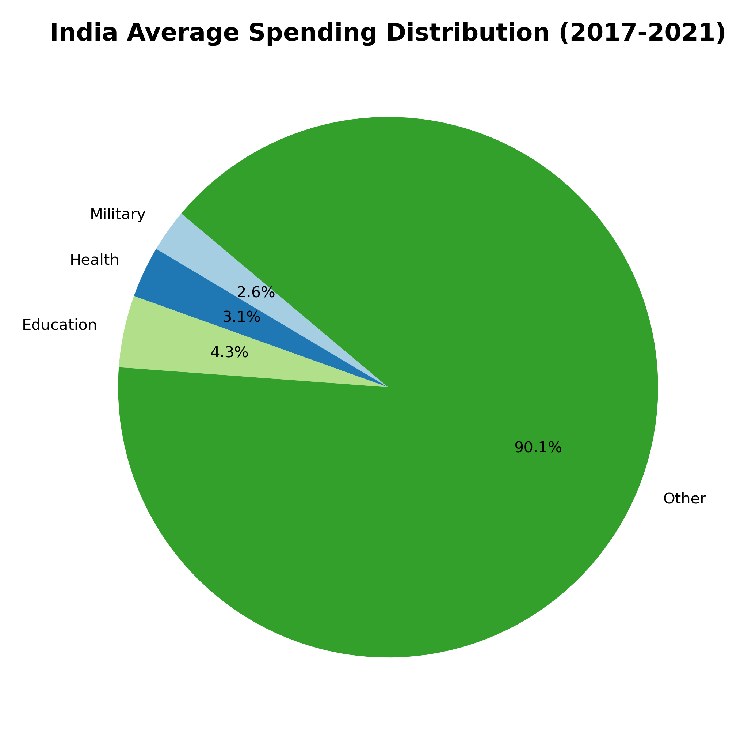
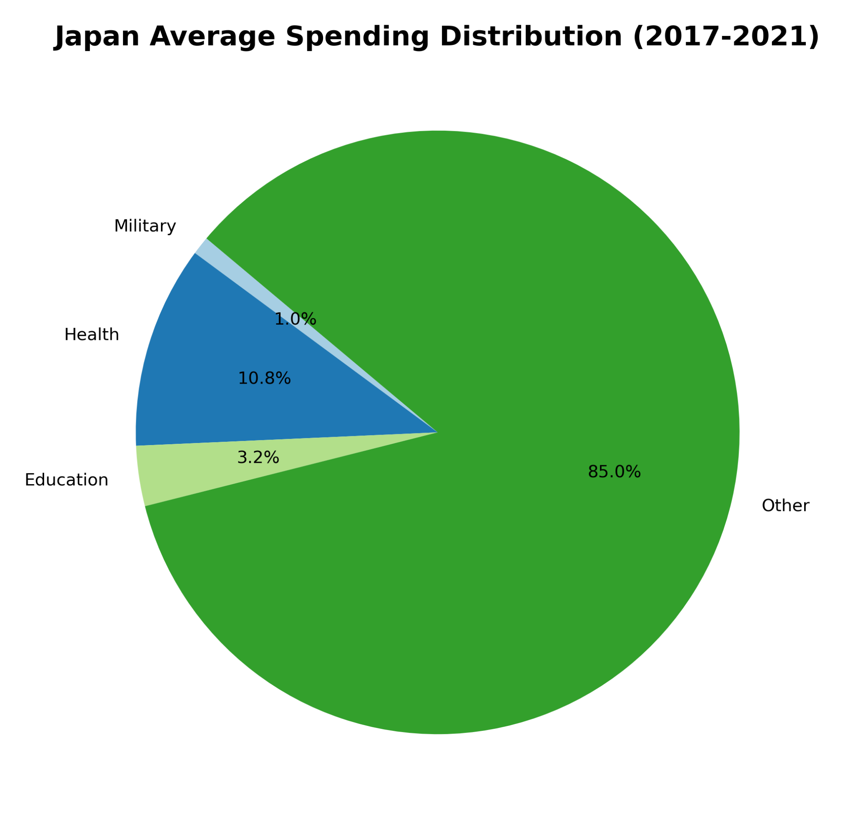
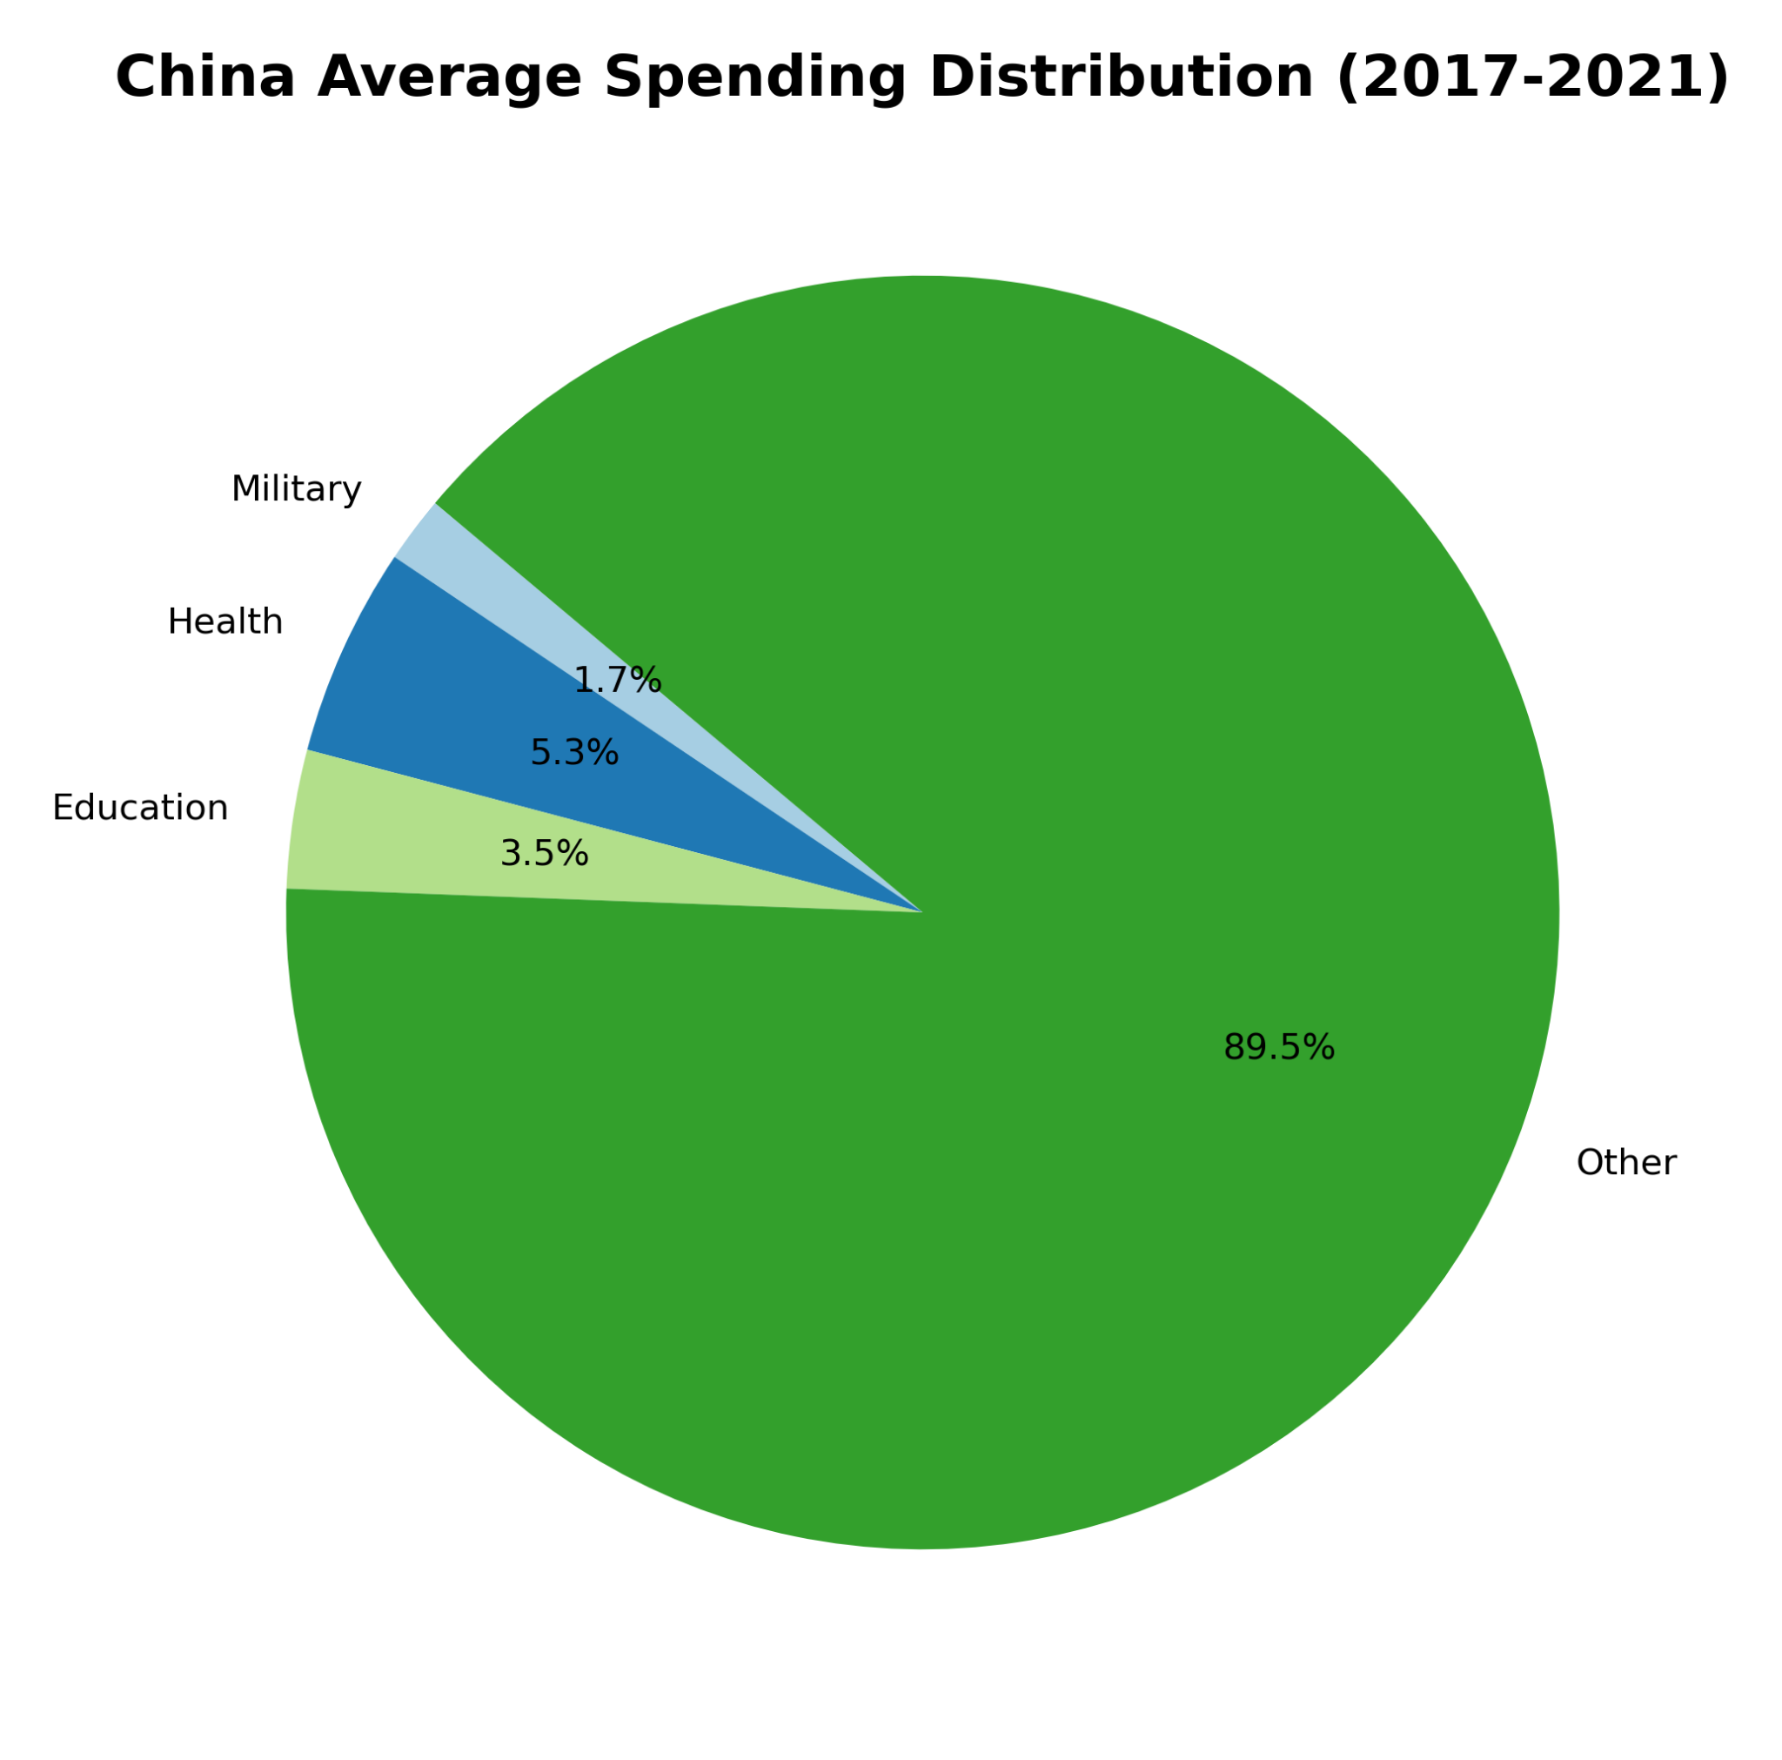
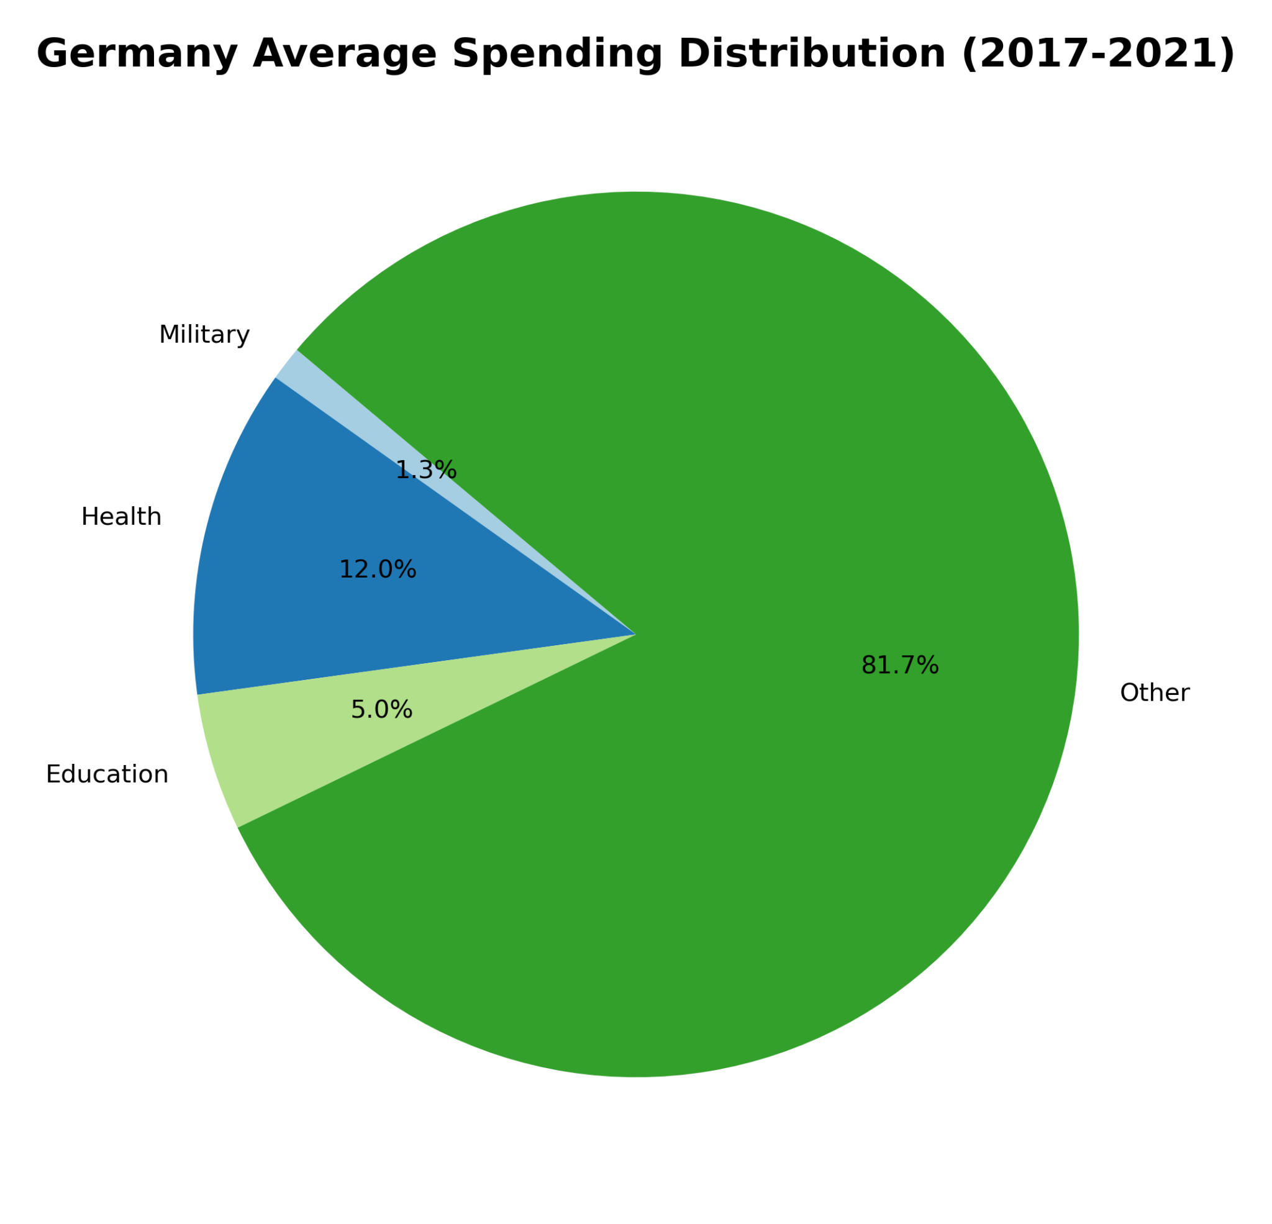
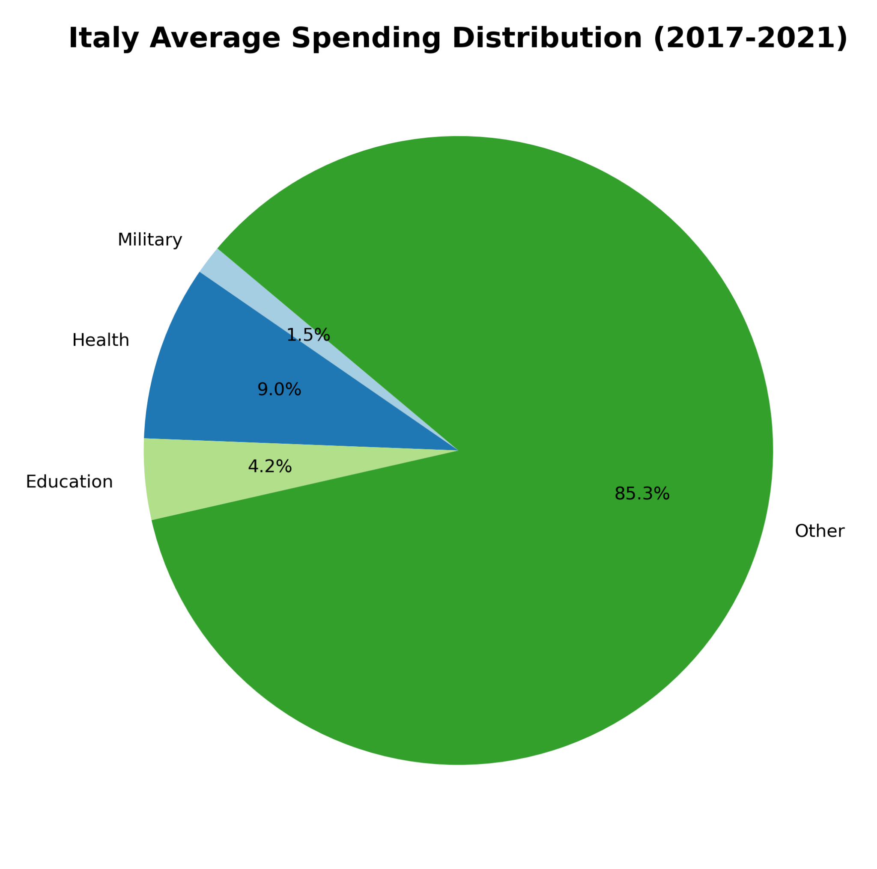
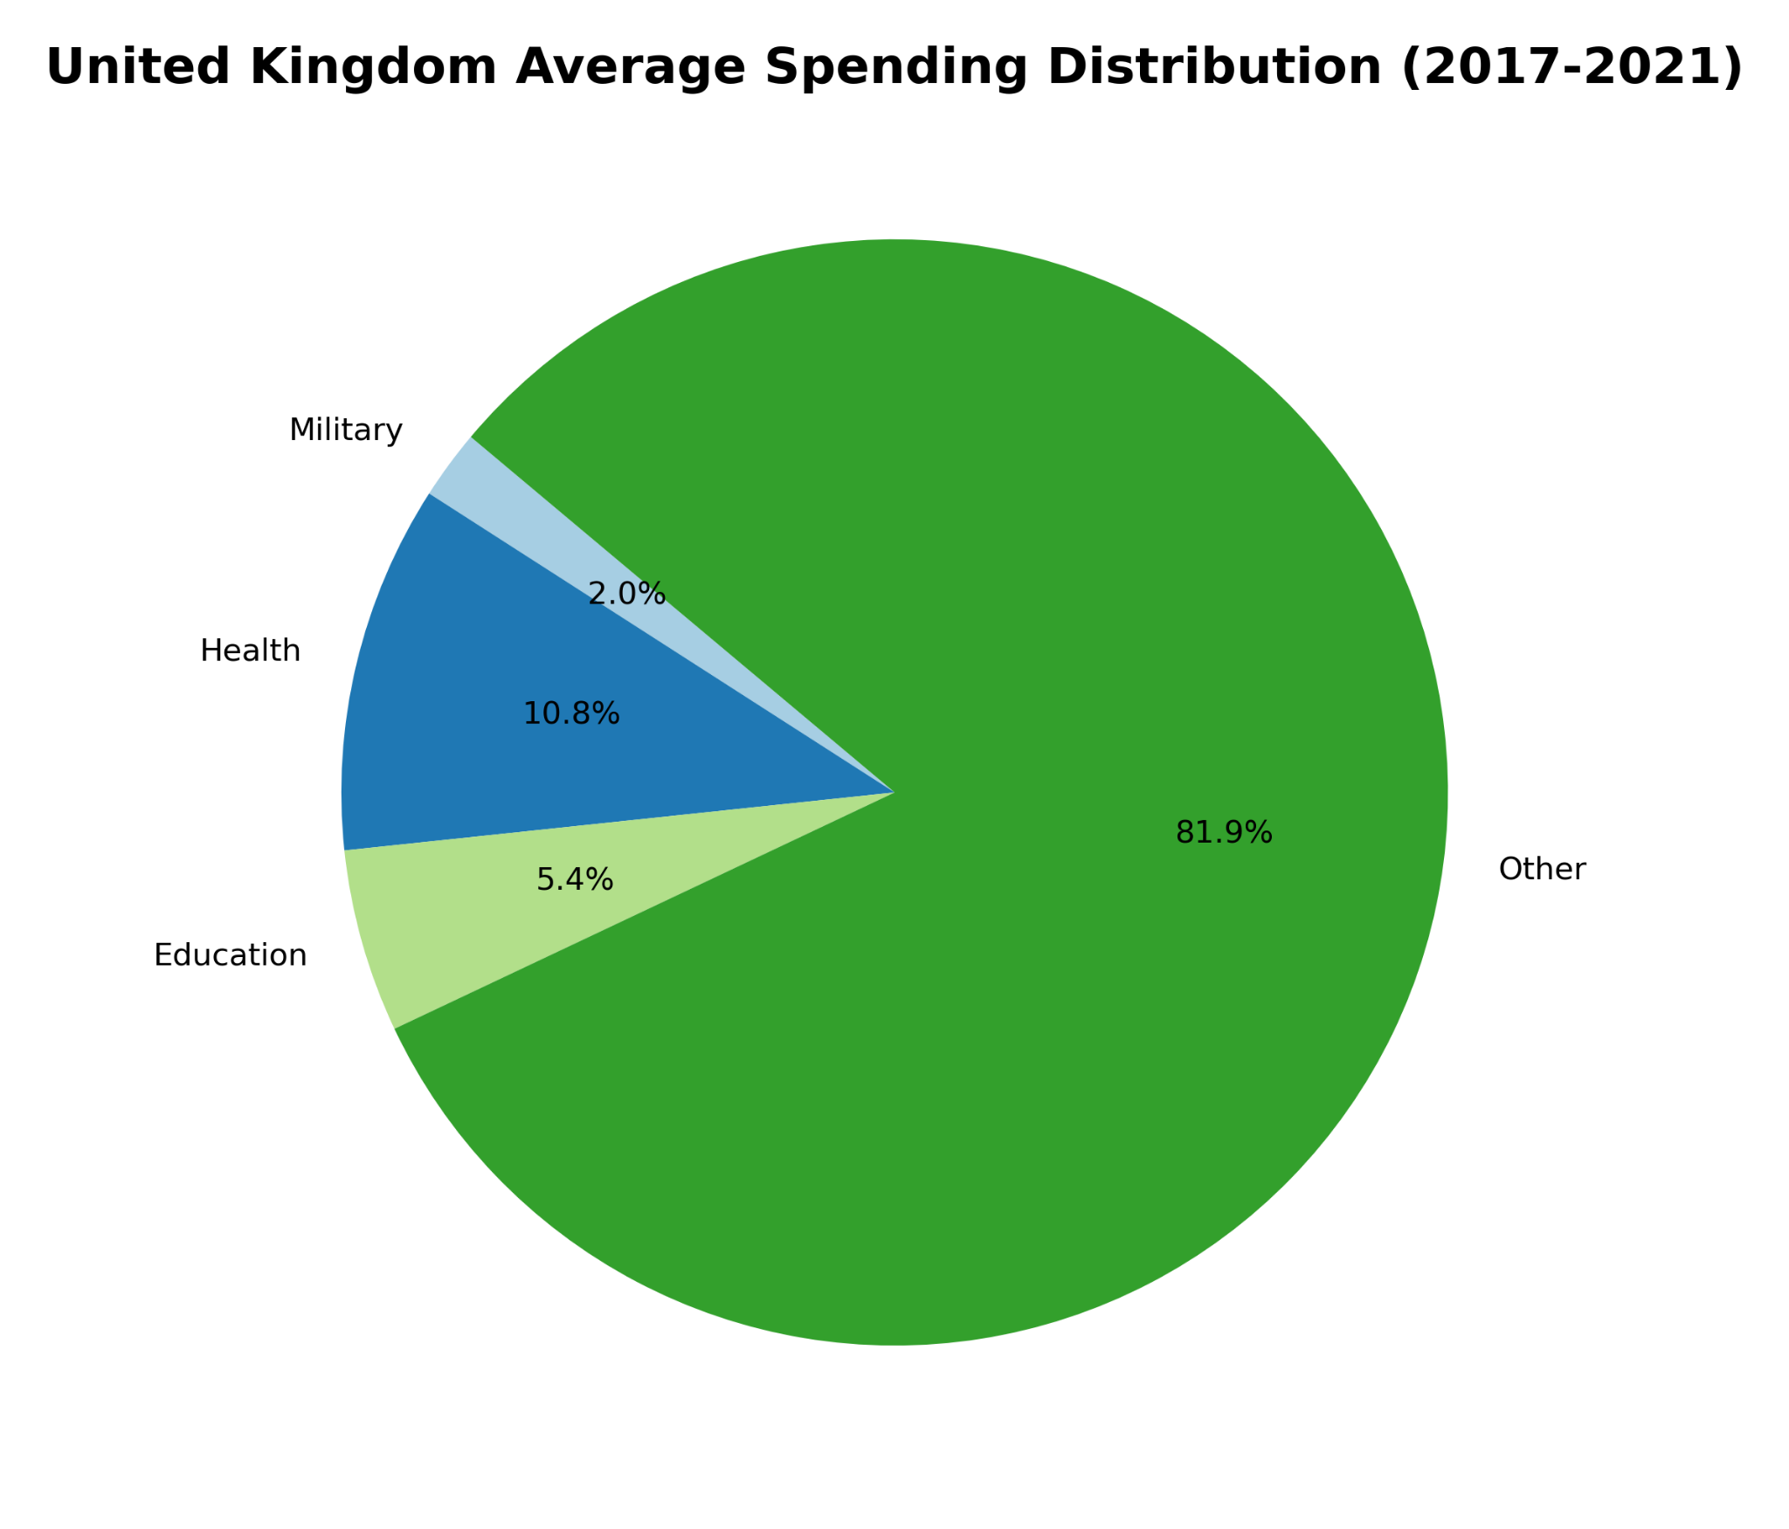
Comparing Education, Healthcare, and Military Spending Per Country
Notes:
Here we are comparing the gdp spending distributions. Looking at these pie charts, we can see that all of these countries do not spend alot on their military, but instead have a large focus on healthcare with education as their second priority.

Slide 7
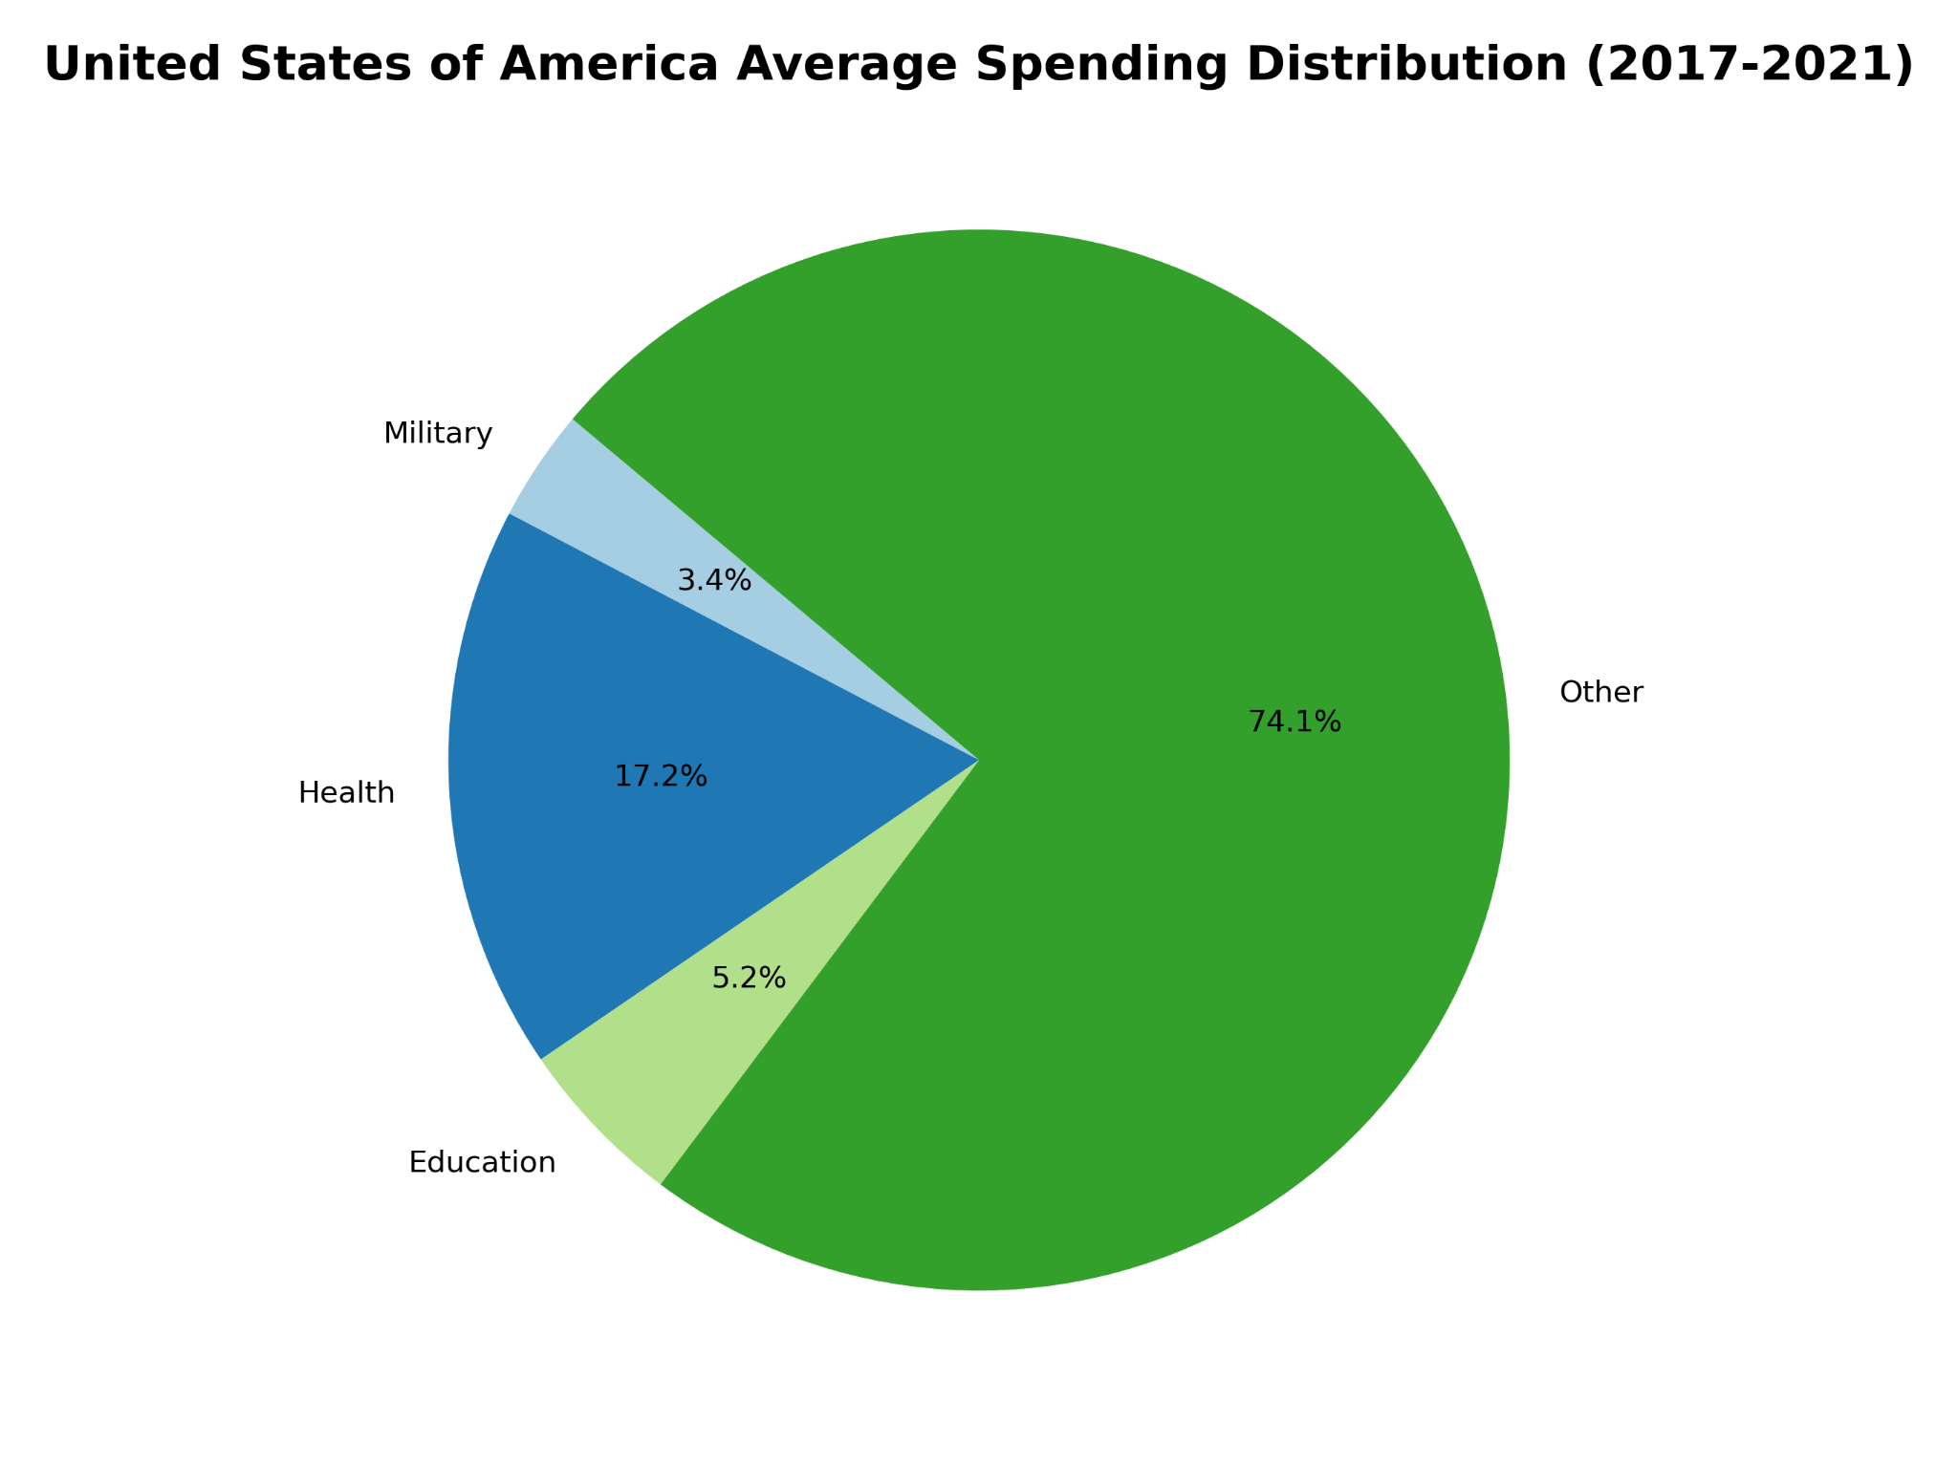
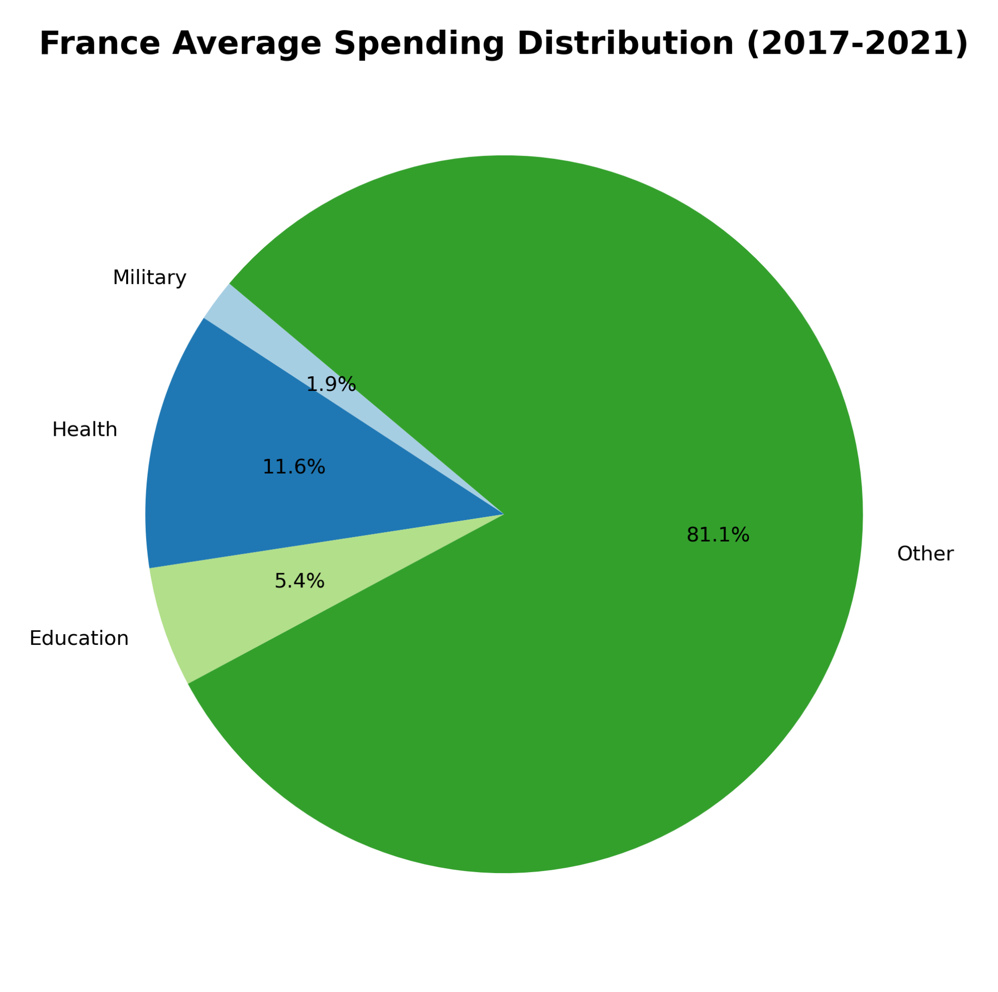
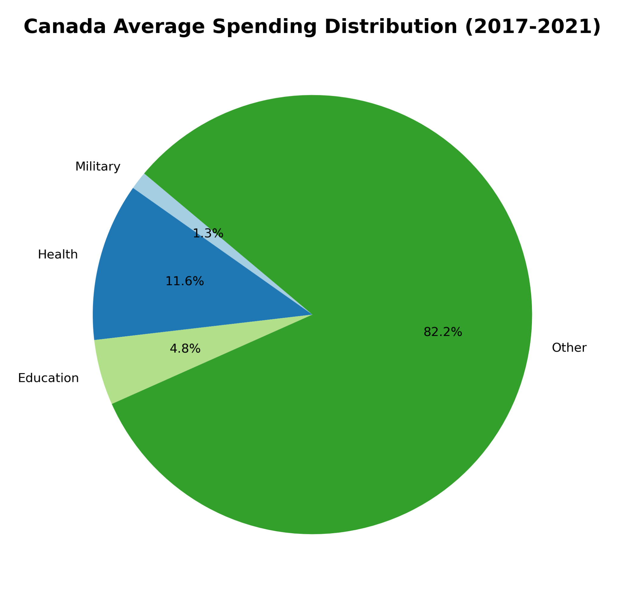
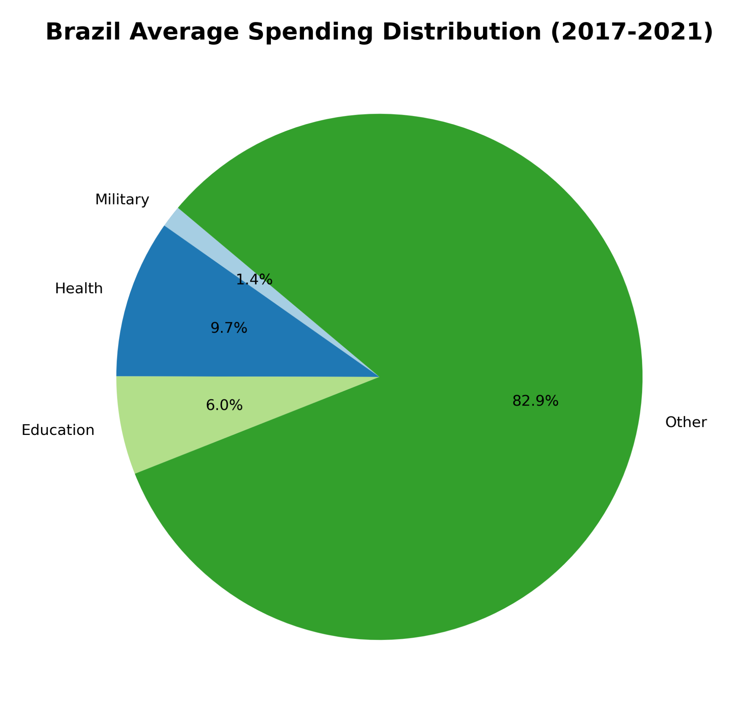
Comparing Education, Healthcare, and Military Spending Per Country
Notes:
Looking at the large green areas labeled ‘other’ we can see that the us spends much more on their healthcare, education, and military compared to the rest of the countries. The lower the number, the more spent. The us is the only country out of the top 10 that has their ‘other’ percentage in the 70s while the rest are all in the 80s.

Slide 8
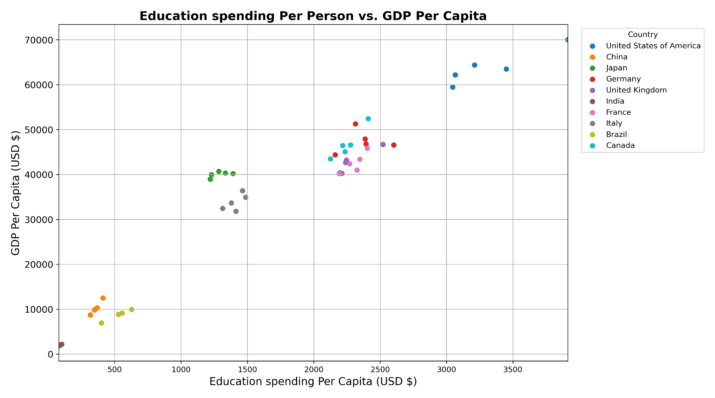
Spending Per Capita vs GDP Per Capita (in USD $)
Notes:
Here we have the education spending per capita vs gdp per capita. India’s values are extremely low. Since their gdp per capita is already so low, their education per capita is almost 0.

Slide 9
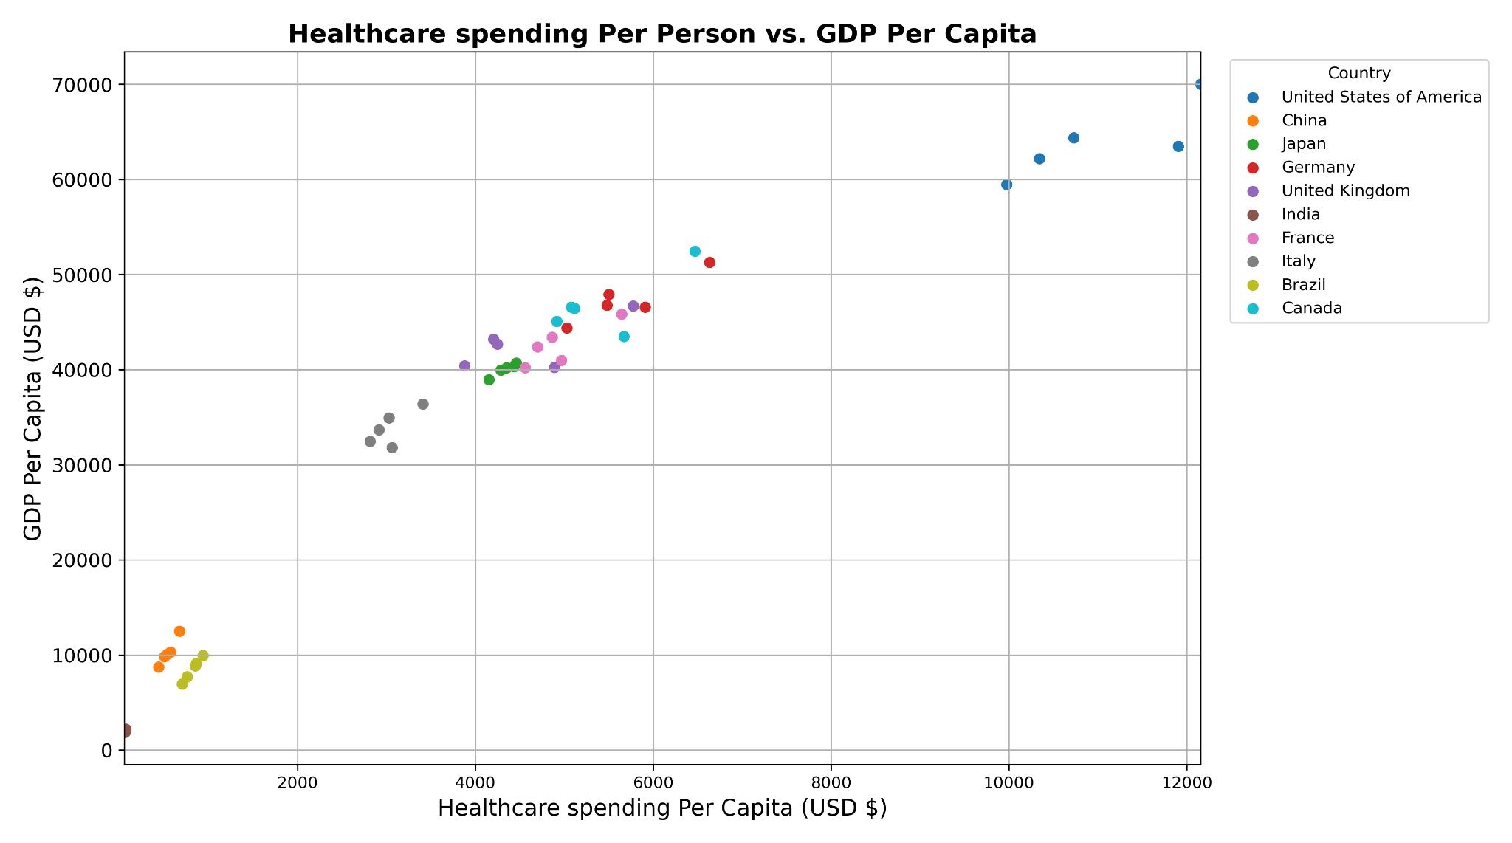
Spending Per Capita vs GDP Per Capita (in USD $)
Notes:
The data is very similar. Countries in the lower regions remain there, but with the majority data in the middle of the plot, we can see that the points have shifted over alot to the left. This does not mean anything because the x axis labels became bigger.

Slide 10
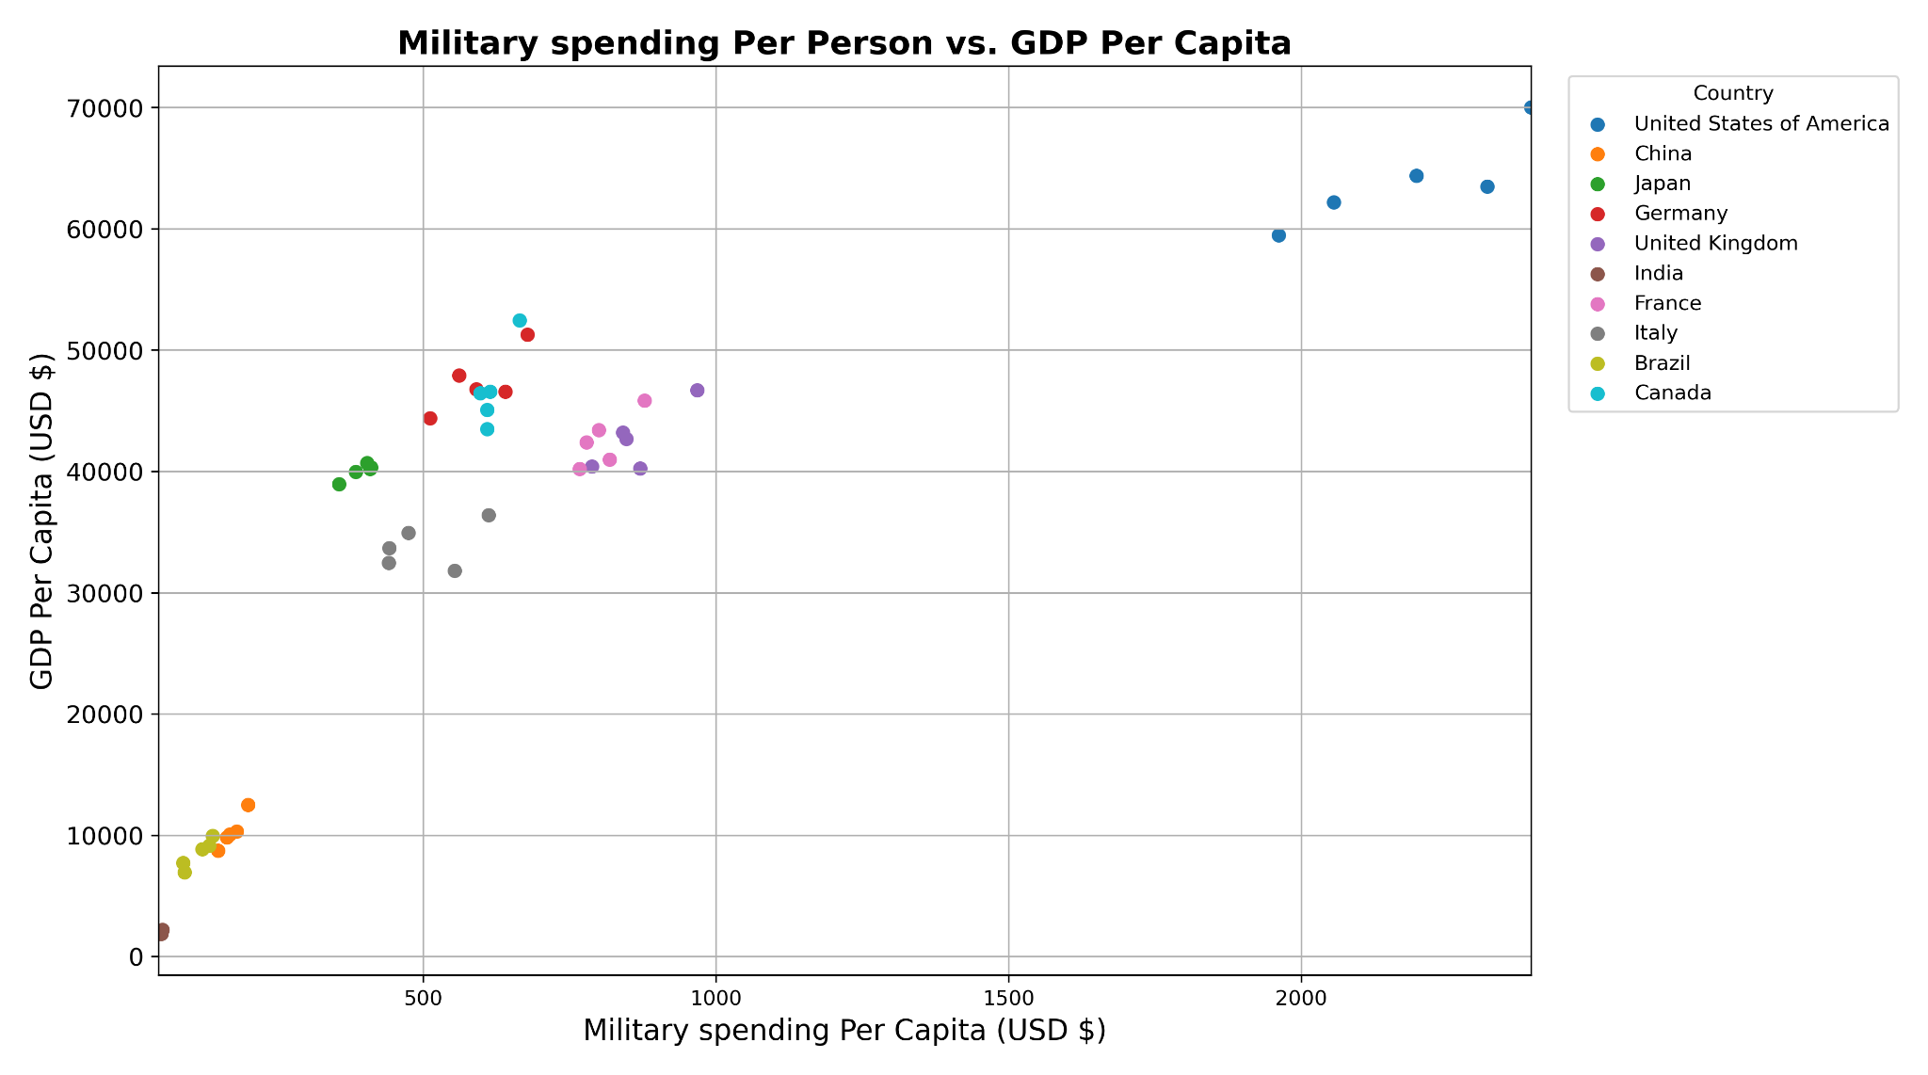
Spending Per Capita vs GDP Per Capita (in USD $)
Notes:
Lastly for the military spending per capita, most of the countries have stayed in the same general spot. The only difference is that the x axis labels became much smaller bc if we remember from the previous graphs, the spending on military was on a much smaller scale compared to the other categories.

Slide 11
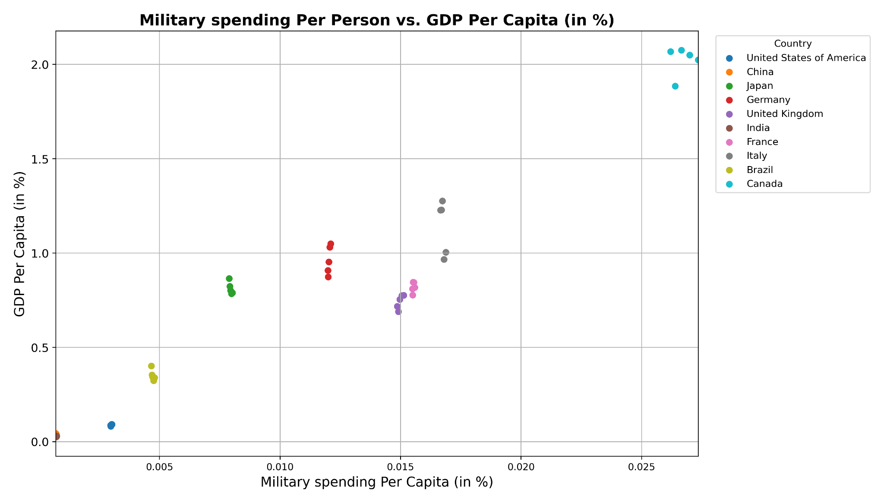
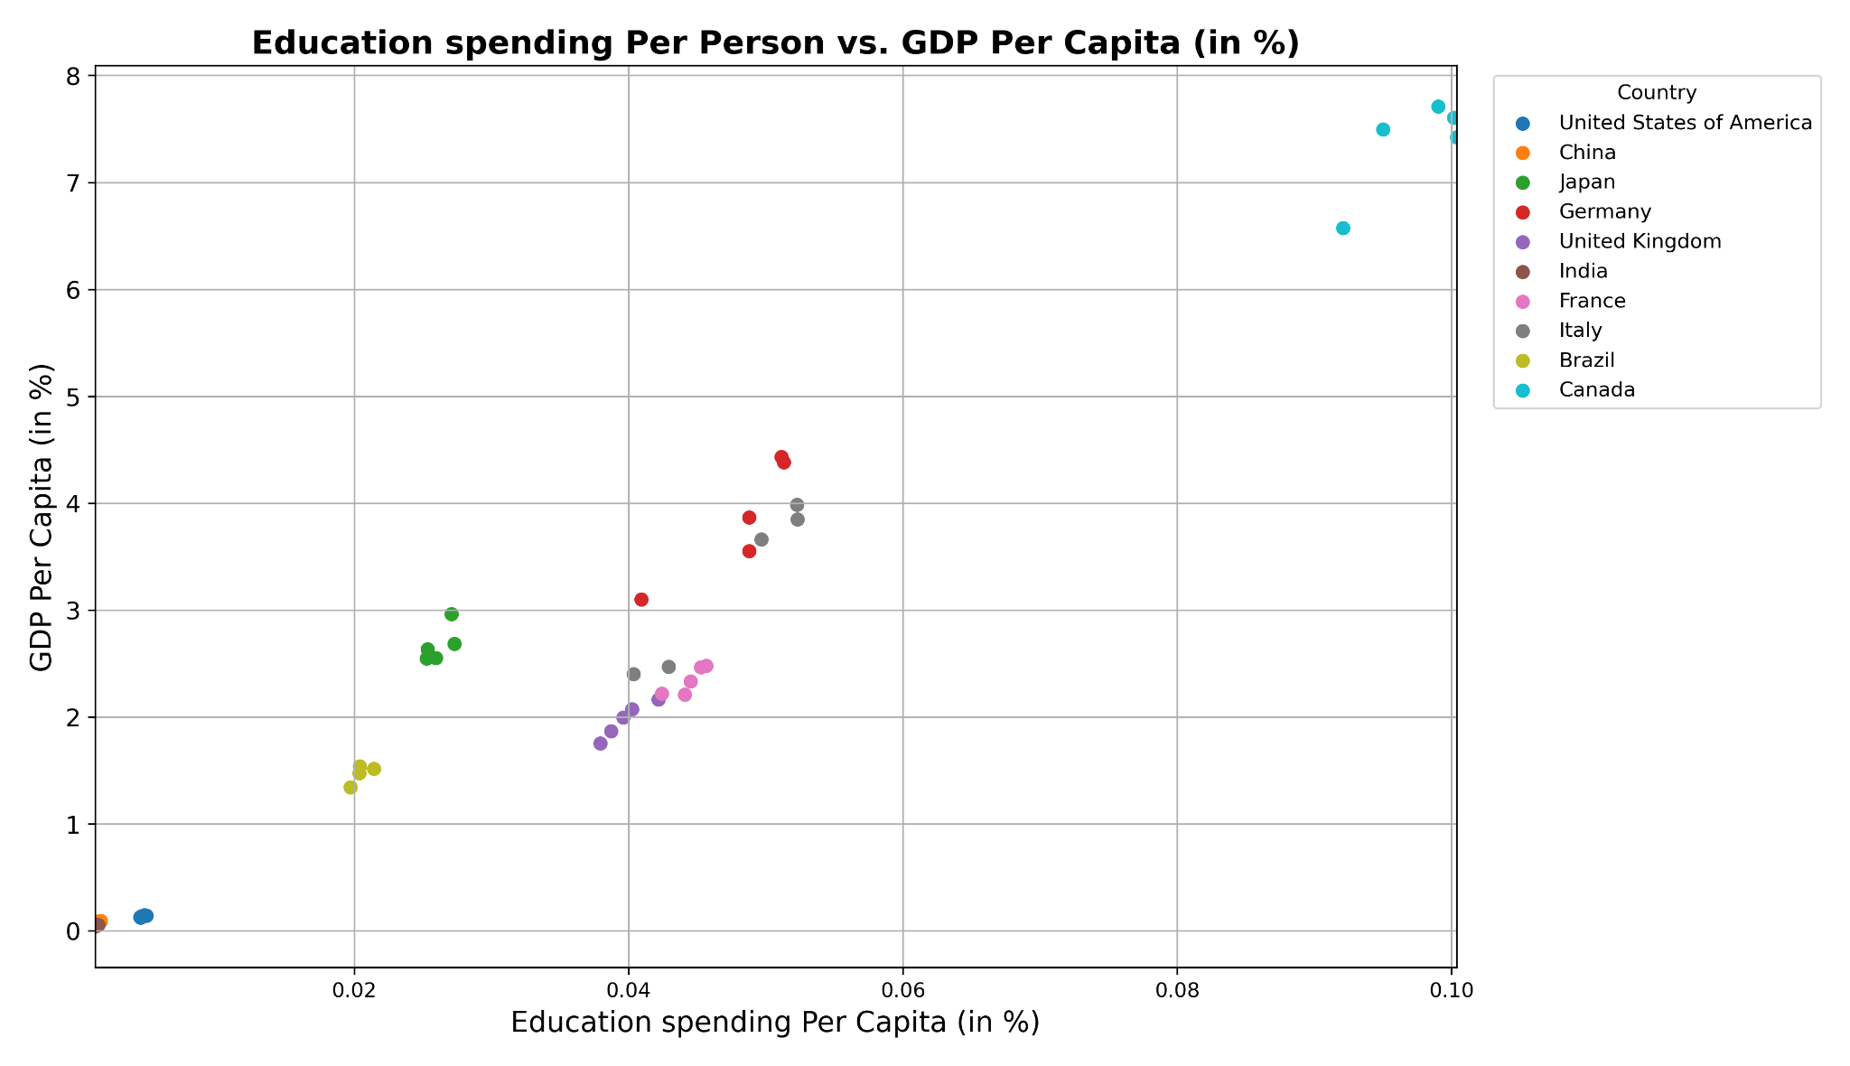
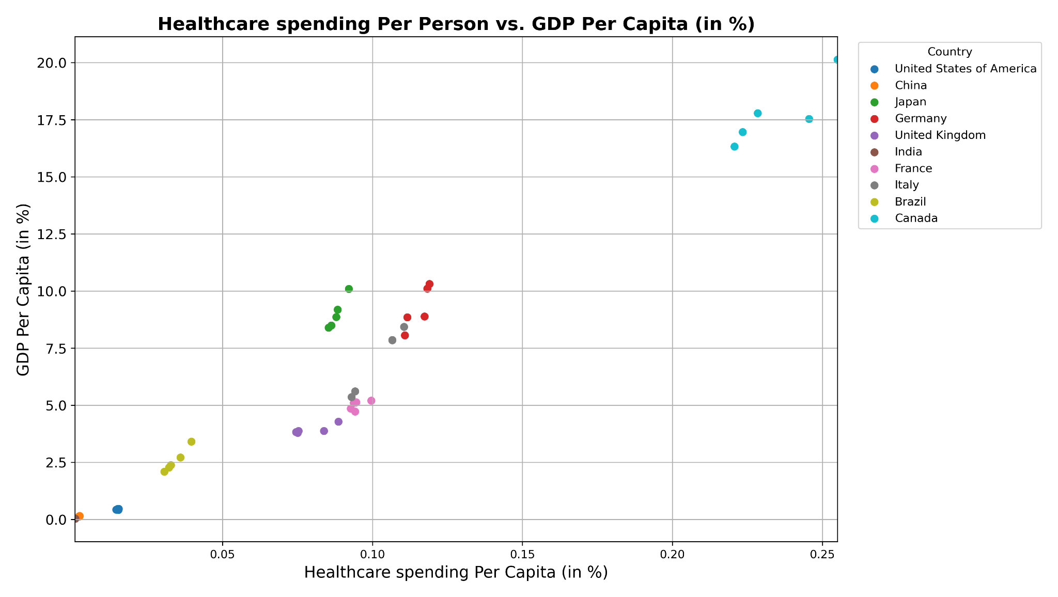
Spending Per Capita vs GDP Per Capita (in %)
Notes:
So these plots are similar to the previous ones, but in percentage values. We can see that the healthcare and education plots are the most similar in pattern, and when we look a the military graph, the values are more uniform and less scattered. Each countries’ data points all appear more precise, except for italy.

Slide 12
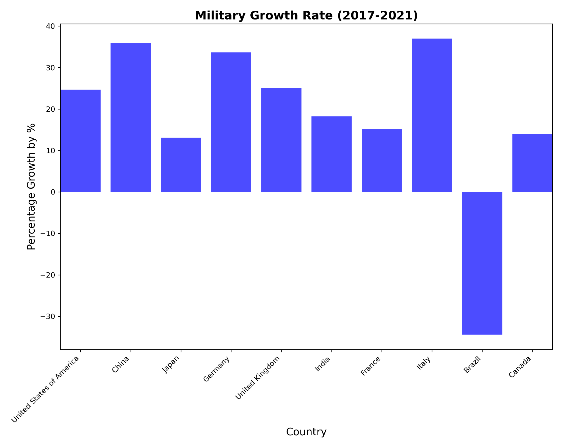
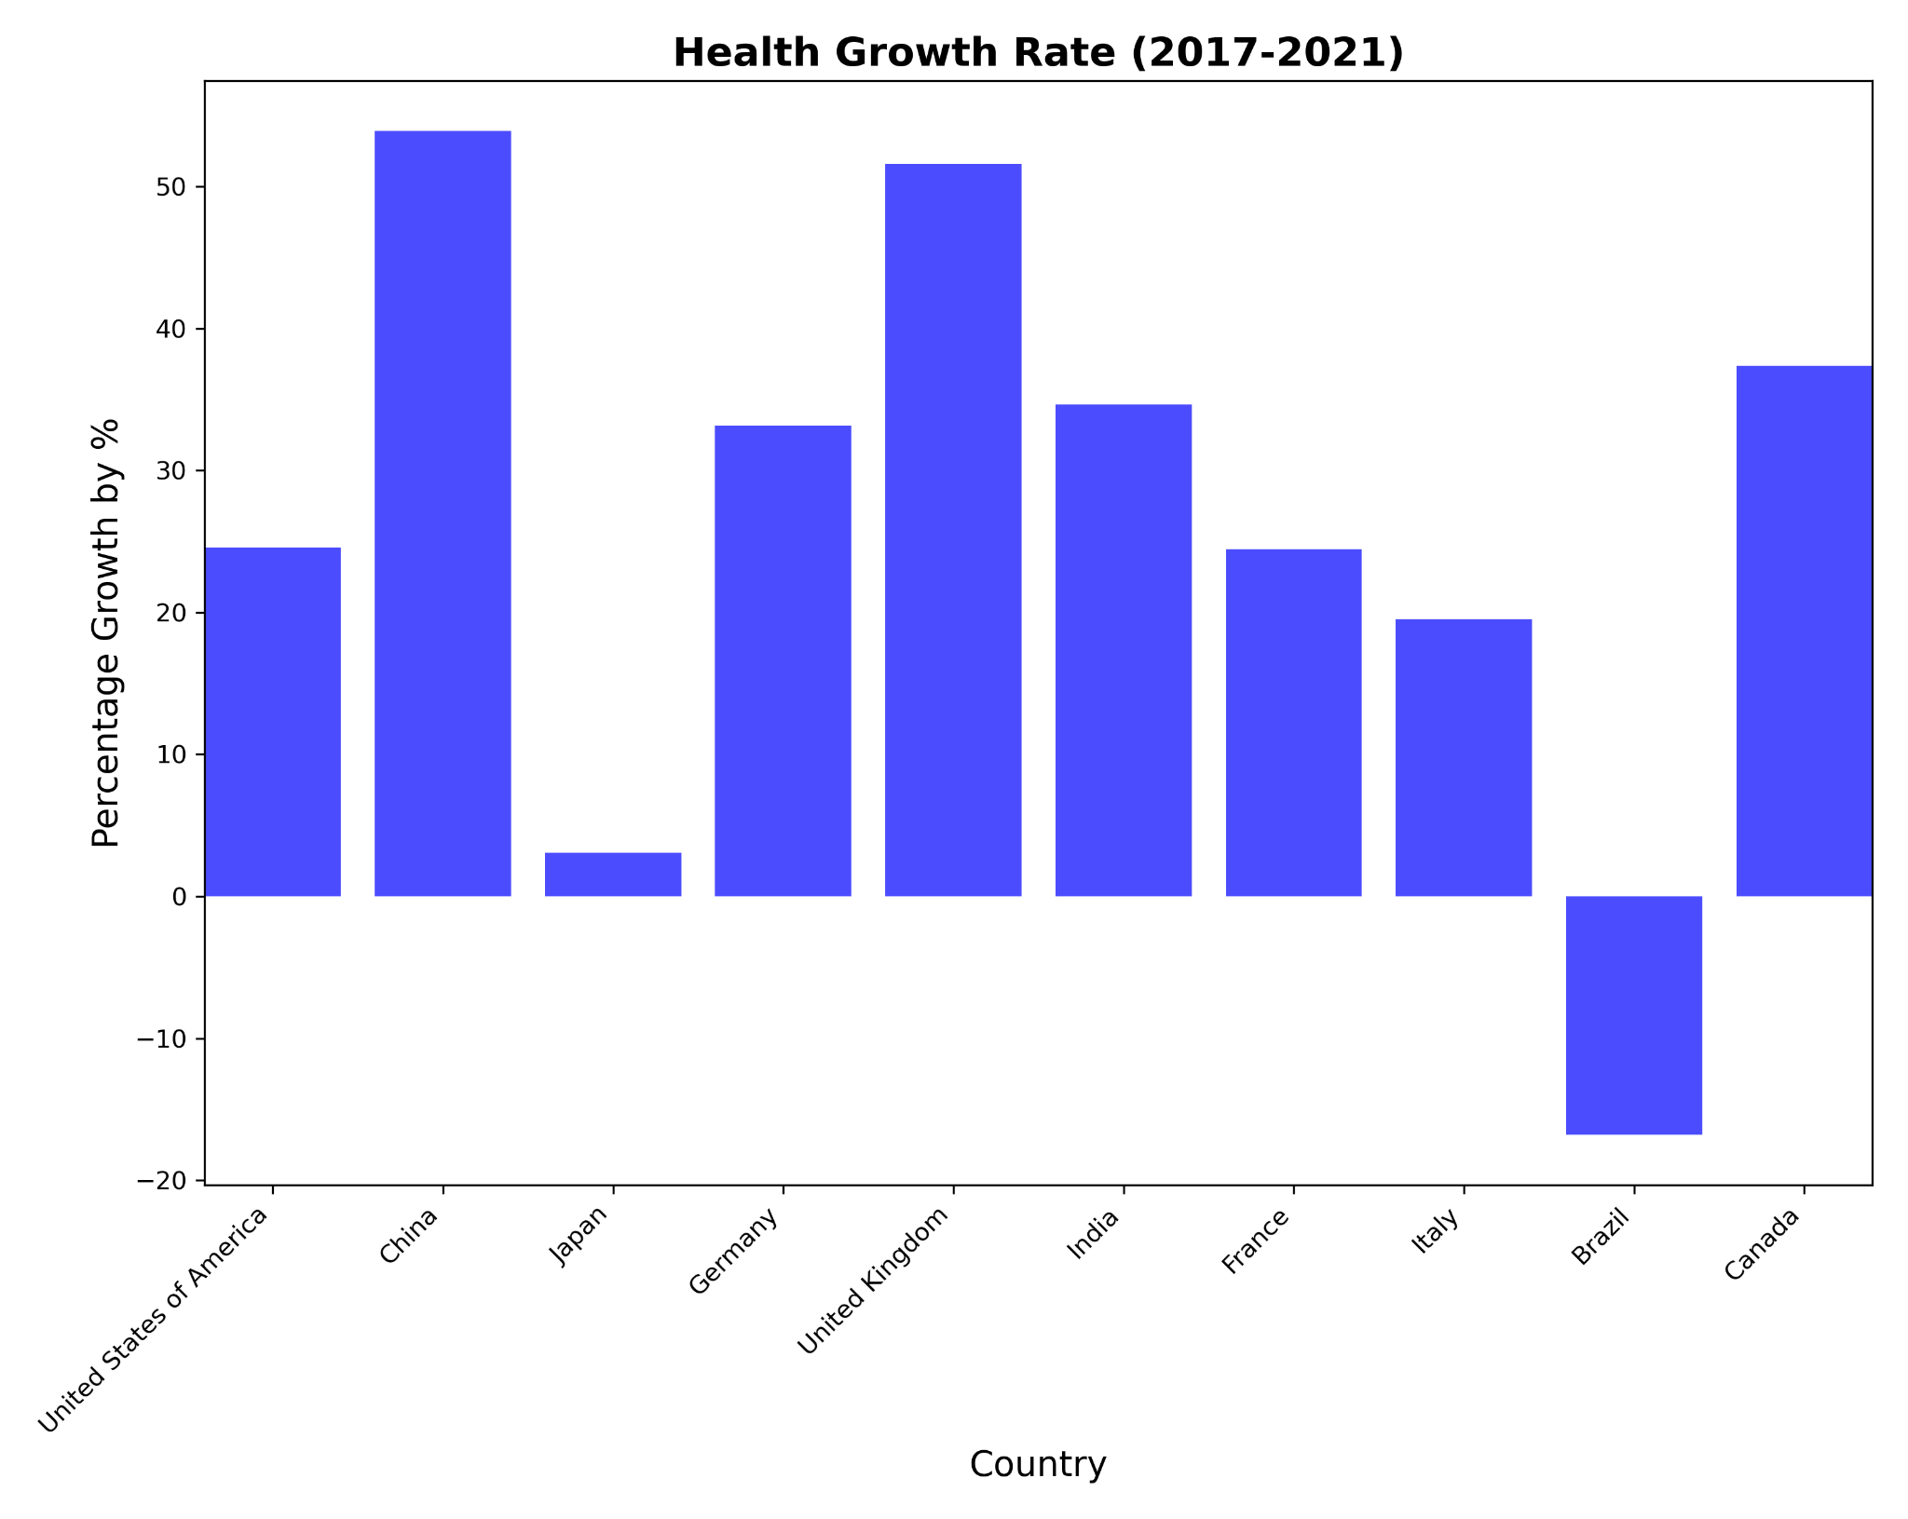
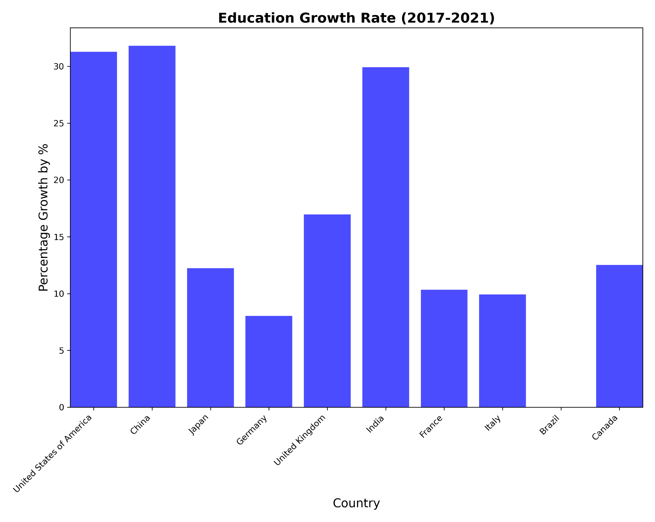
Spending Growth Rate
(in %)
Notes:
Here are the spending growth rates, in percent, by category. This was found by subtracting spending in 2017 from spending in 2021, and then dividing that by the spending in 2017 again. So brazil has the worst growth rates in all three categories, with negative growth in both health and military spending. This means that brazil’s spending in 2017 larger than the spending in 2021. Although india was the smallest spender out of all the countries, they did have the most growth in education spending.

Slide 13
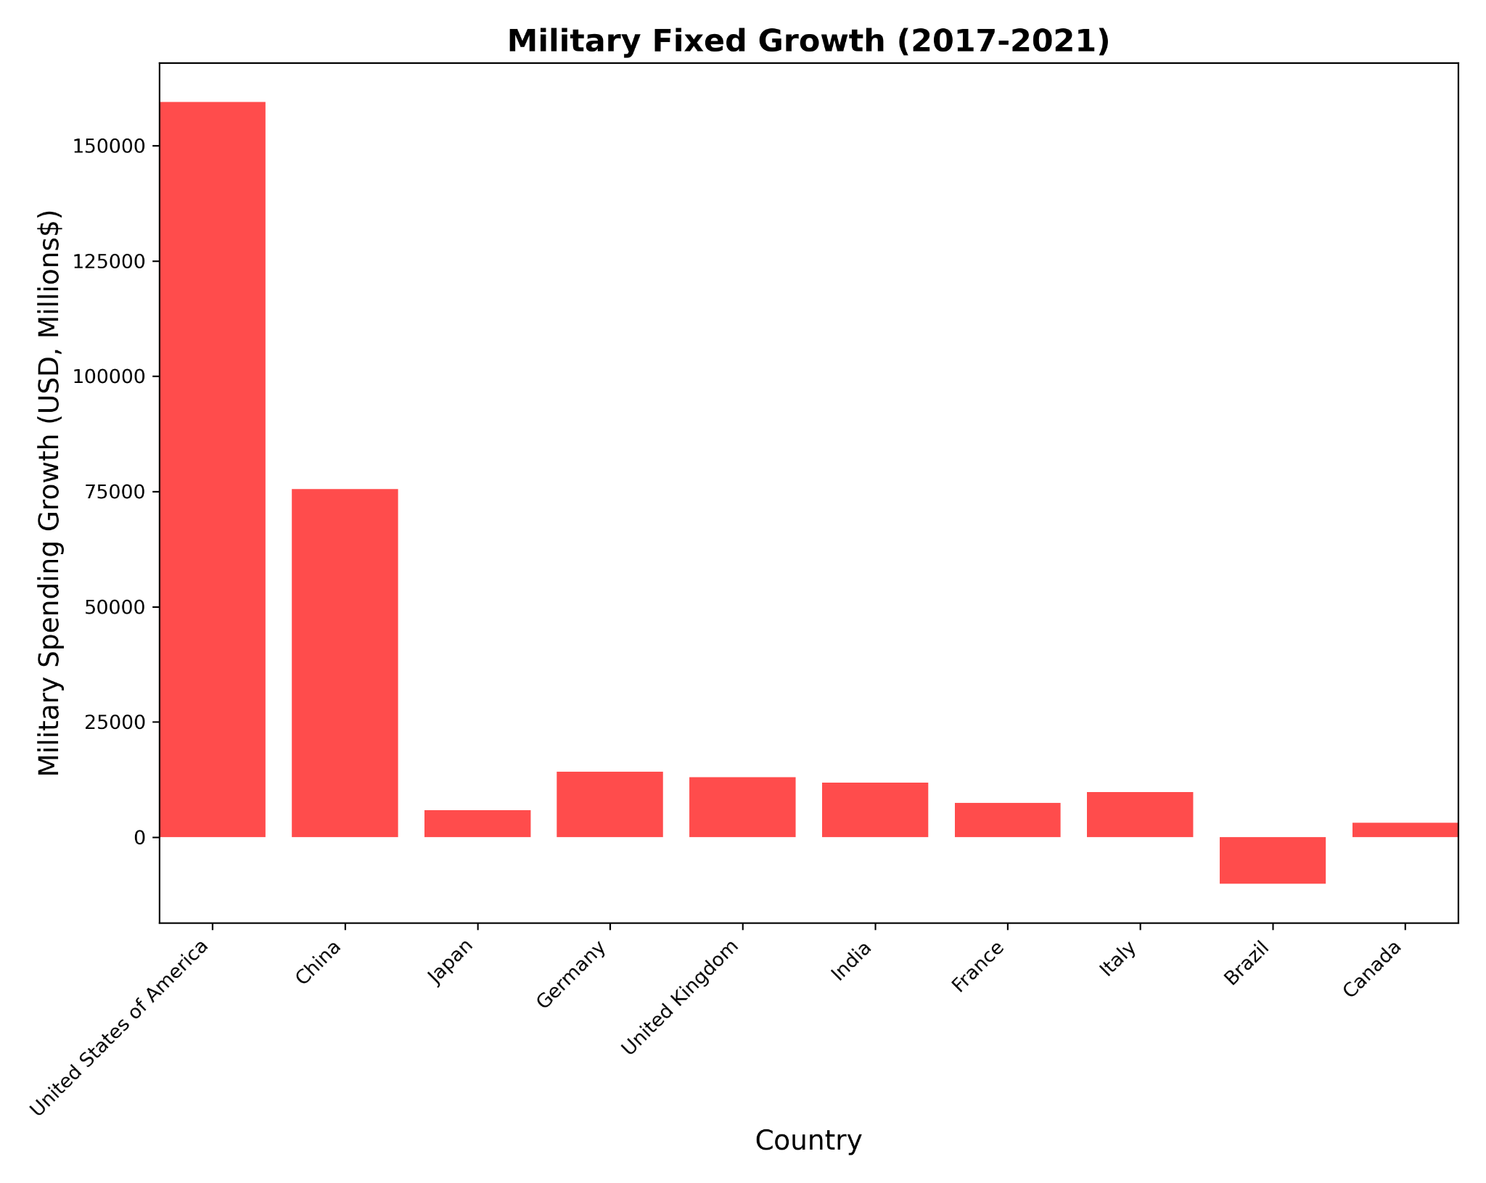
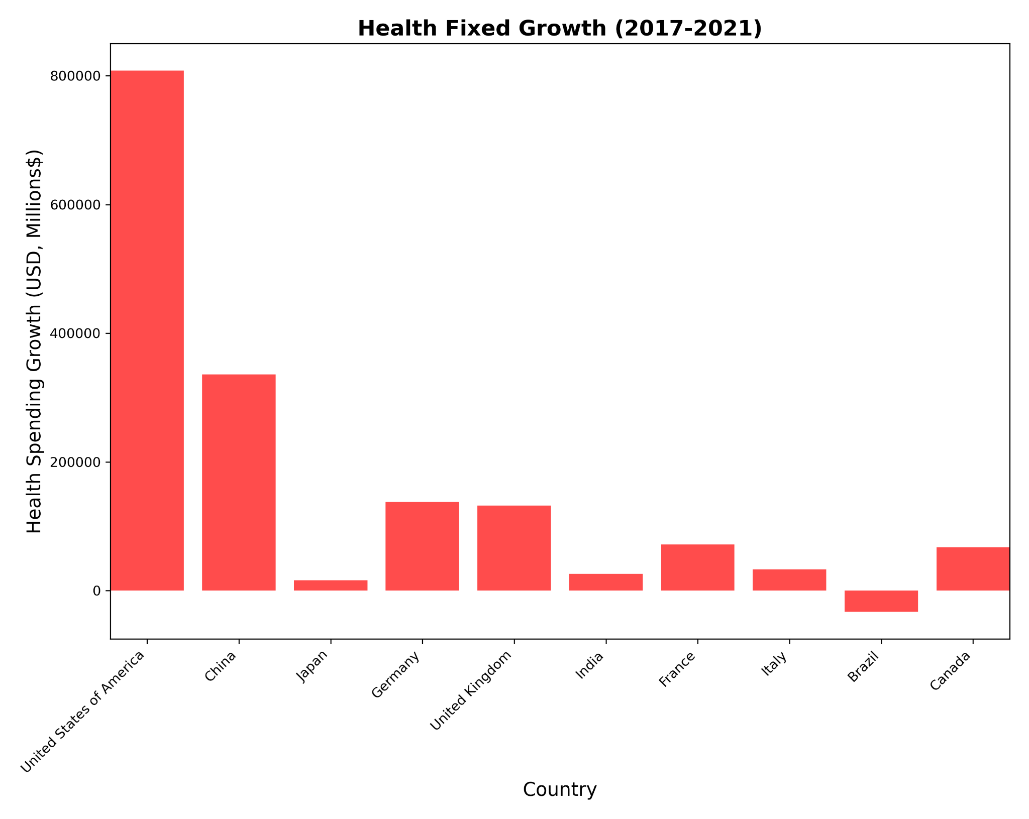
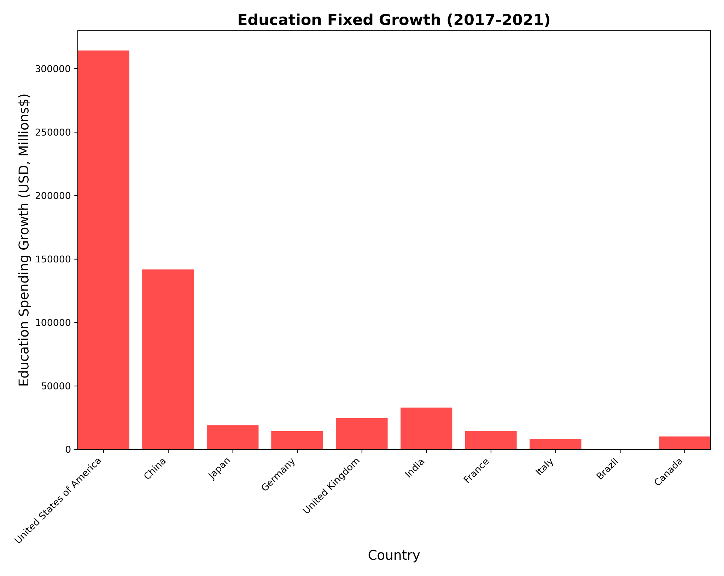
Spending Growth Rate
(Fixed)
Notes:
Here is the spending growth rate in fixed values, so i just took the spending value from 2021 and subtracted it by the spending from 2017. The us overall has the most growth, with china having the second most growth. Again similar to the previous bar charts, brazil has negative growth.

Slide 14
Conclusion
All countries spent the most on healthcare
The US had the most spending across all countries, but this is due to the US having a much larger GDP
Data like Brazil’s can be inaccurate due to missing data.
Although India had the least spending in contrast to the rest of the top 10, they had the most even distribution of spending.
The line plots show a spike in spending in 2020, alluding to the impact of COVID
Healthcare spending increased due to the hospital funding and vaccine development
Education spending increased due to investments in online learning and support for schools
Notes:
With a larger gdp, there is a bigger budget. Even if the proportions are the same, the raw values are just much larger.
The growth rate bar charts had negative values, and while this is accurate, this missing data could have affected the other graphs.
Their spending on healthcare, education, and military were almost all the same

